Slide 1


CREDIT CARD ATTRITION PREDICTION
CREDIT CARD ATTRITION
RATE PREDICTION
SUBMITTED BY
VISHNU VENUGOPAL

Slide 2
CONTENTS
Problem Statement
Objective of this project
Process followed in the project
Importing libraries
Dataset information
Target Variable
Visualization
Boxplots
Multicollinearity
Models
Accuracy score of Models
Conclusion

Slide 3
PROBLEM STATEMENT
A business manager of a consumer credit card bank is facing the problem of credit card customer attrition.
They want to analyze the data to find out the reason behind this and leverage the same to predict customers who are likely to drop off.
Understanding how attrition impacts your current revenue goals and making predictions about how to manage those issues in the future also helps you stem the flow of churned customers.

Slide 4
OBJECTIVE OF THIS PROJECT
Help the business manager to figure out how and what are the reasons behind consumer credit card attrition.
Applying Machine Learning Algorithms for better results.
Attrition Flag is the target/output variable represents the current status of customers. It has two unique values: one is Existing Customer (current customer) and Attrite Customer (churned customer).

Slide 5
PROCESS FOLLOWED IN THE PROJECT
Importing Libraries and Dataset
Checking null values , Treating outliers & Exploratory Data Analysis
Data preparation, Statistical tests, Checking Multicollinearity, VIF, Smote & Data Preprocessing
Model Building Using ML Algorithms
Conclusion

Slide 6
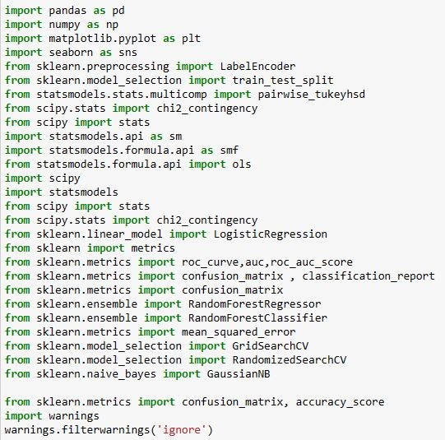
IMPORTING LIBRARIES
Import the libraries which is need for this project. Python libraries are used to create applications and models in a variety of fields, for instance, machine learning, data visualization, image and data manipulation, and many more.

Slide 7
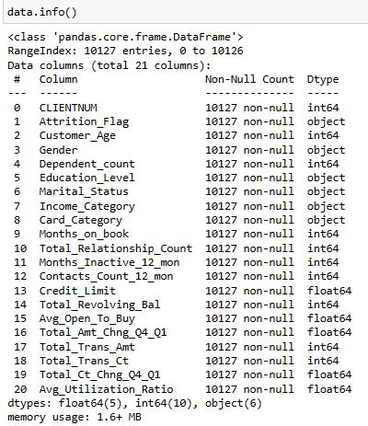
DATASET INFORMATION
Dataset has 10127 rows and 21 columns.
int datatype - 10
object data type - 6
float data type - 5
No null values.

Slide 8
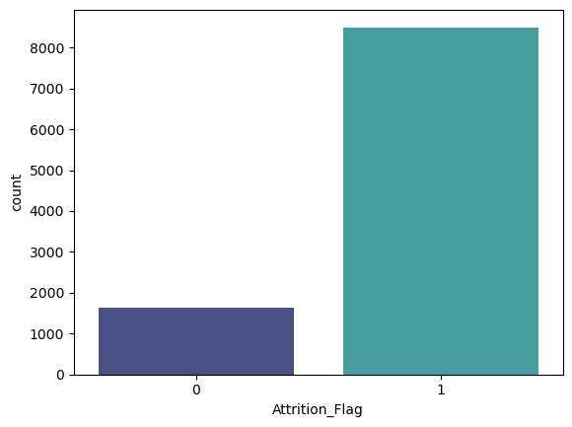
TARGET VARIABLE - ATTRITION FLAG
Attrition_Flag: this target/output variable represents the current status of customers. It has two unique values: one is Existing Customer (current customer) and Attired Customer (churned customer).

Slide 9
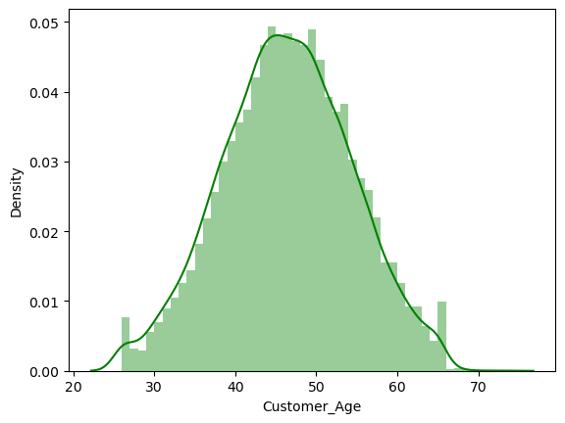
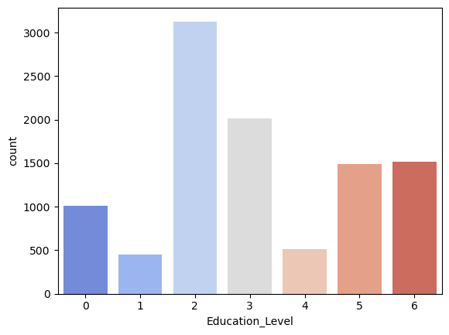
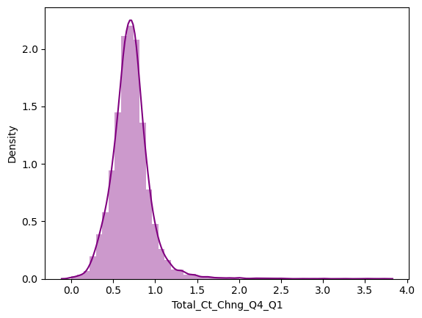
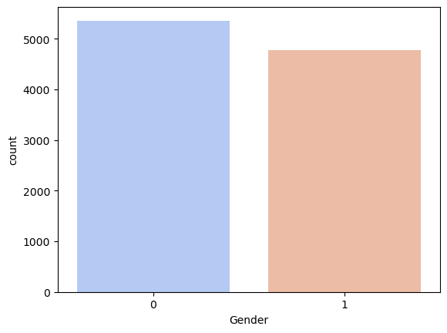
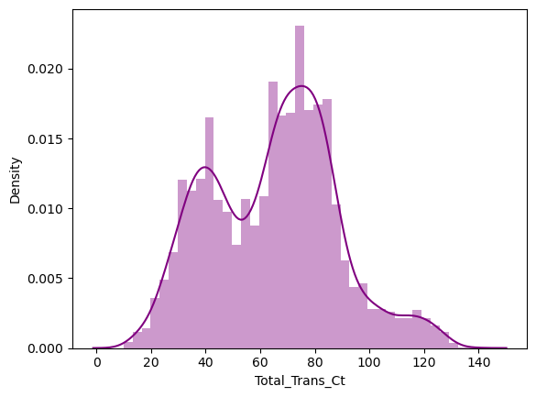
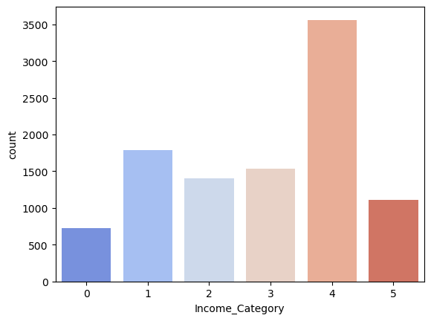
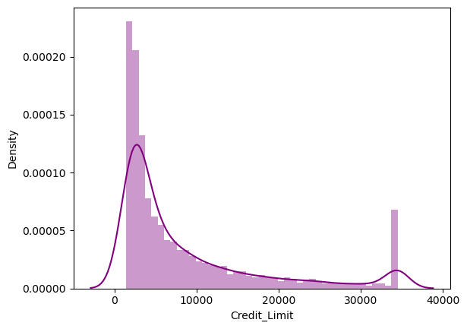
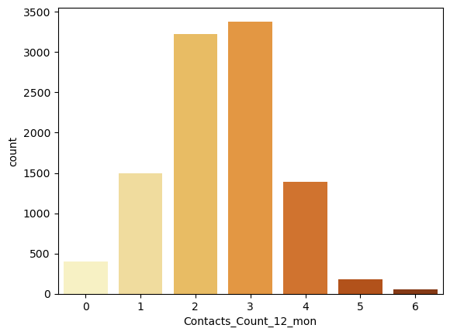
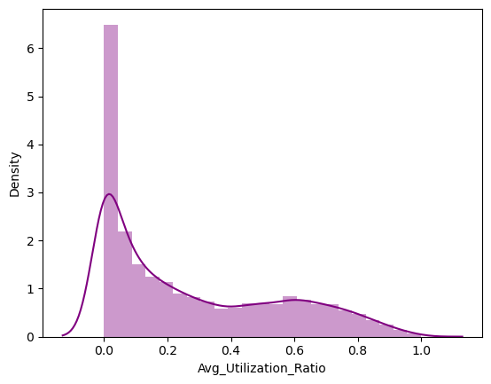
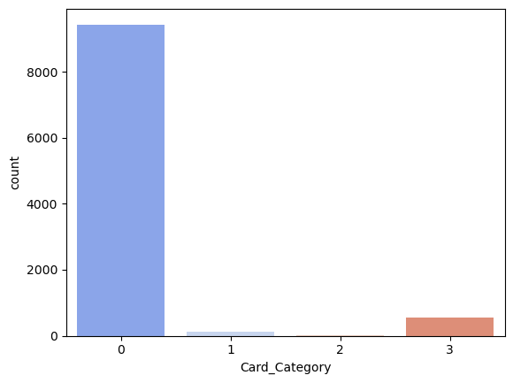
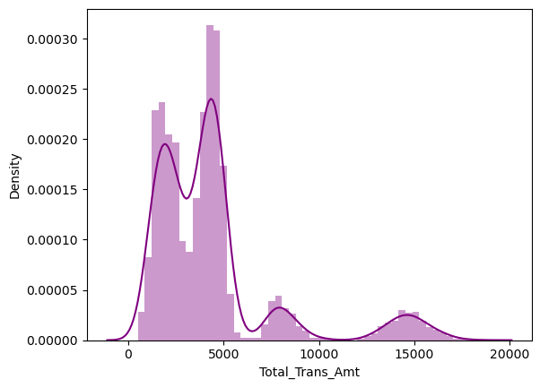
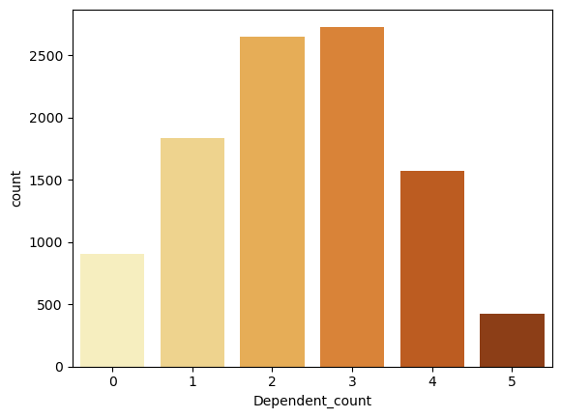
VISUALIZATION OF VARIABLES

Slide 10
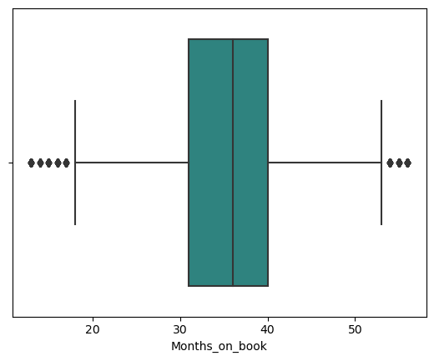
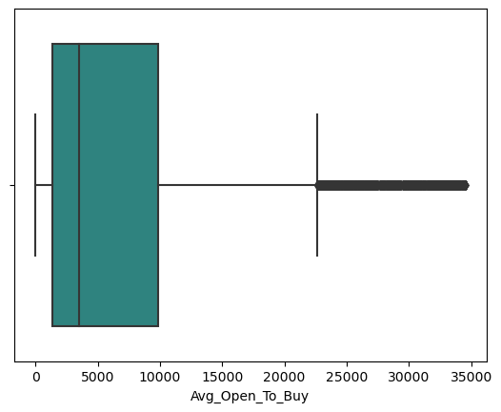
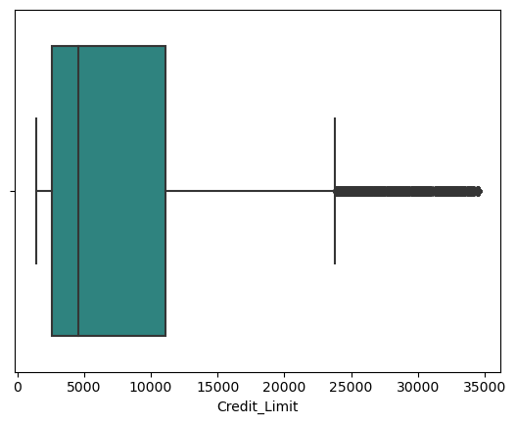
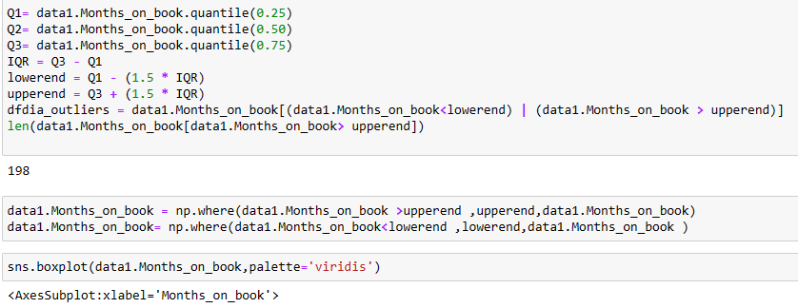
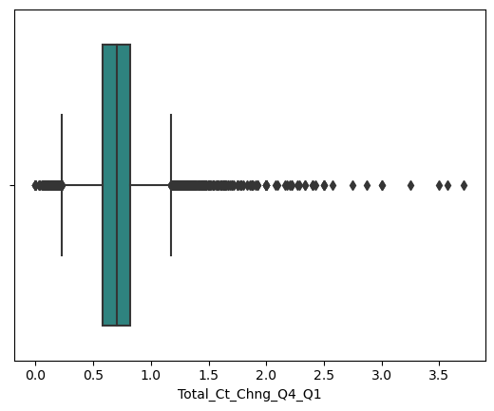
BOXPLOTS FOR FINDING OUTLIERS
It divides the data set into three quartiles.
This graph represents the minimum, maximum, median, first quartile and third quartile in the data set.
Used to detect the outliers.
Code for treating outliers

Slide 11
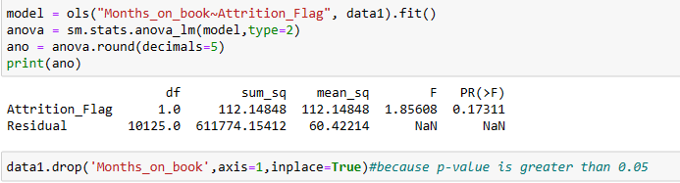
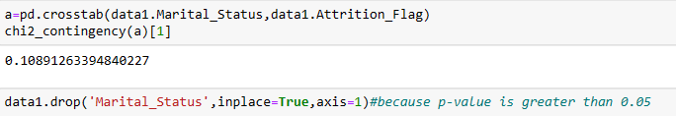
STATISTICAL TESTS
Anova
Chi Square
Drop the column if p-value greater than 0.05

Slide 12

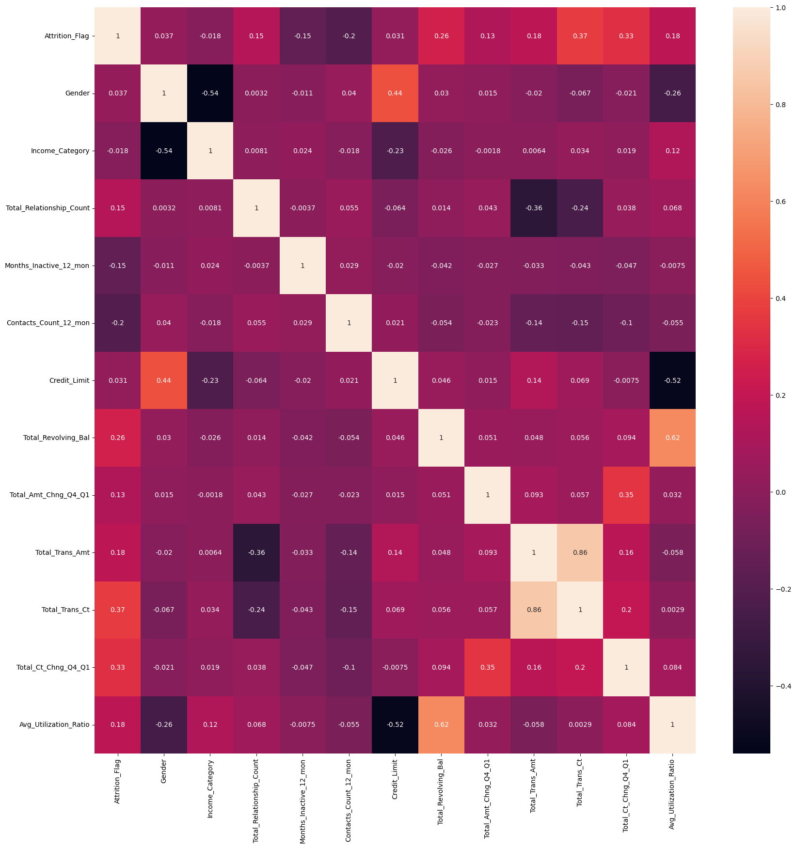
MULTICOLLINEARITY

Slide 13
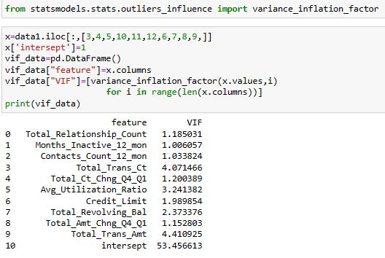
VIF
VIF values are ok so no need to drop any column.

Slide 14
MODELS
Logistic regression Base model
Logistic regression statistical method
Logistic regression Smote
Decision tree method
Random forest_Gridsearch
Random forest_Randomsearch
Naive_Bayes_classifier
KNN kd tree
KNN ball tree
SVM

Slide 15
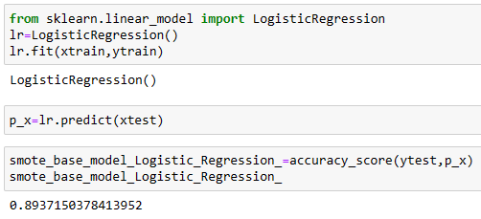
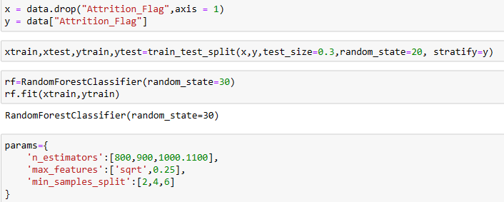
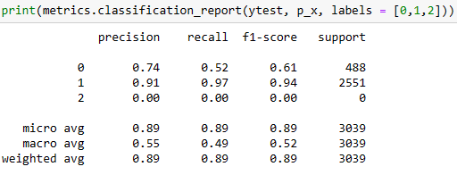
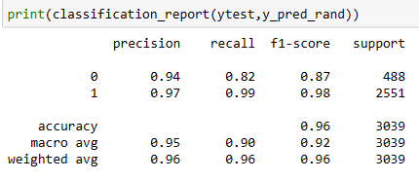
LOGISTIC REGRESSION
RANDOM FOREST

Slide 16
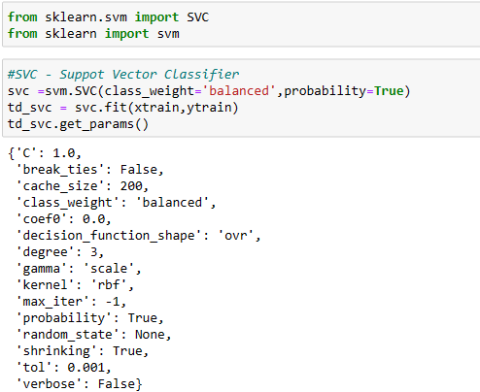
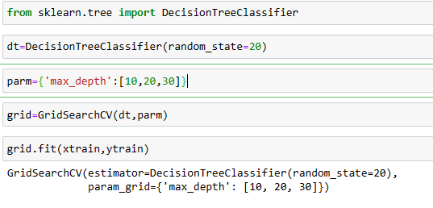
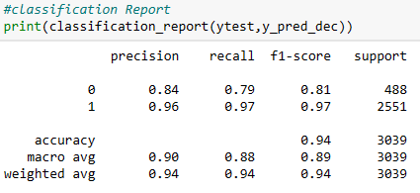
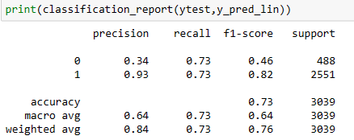
DECISION TREE
SVM

Slide 17
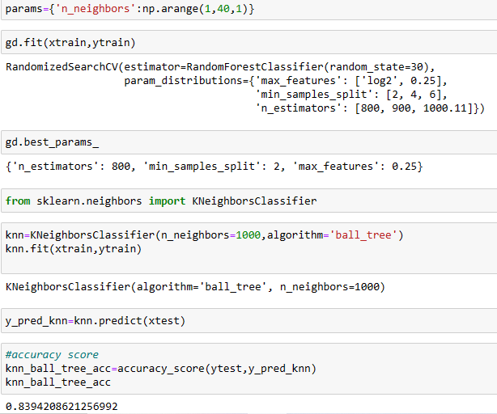
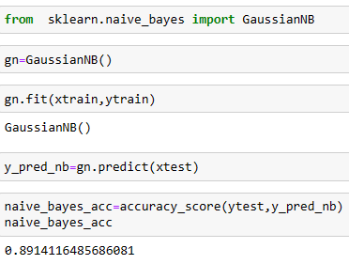
KNN
NAIVE BAYES

Slide 18
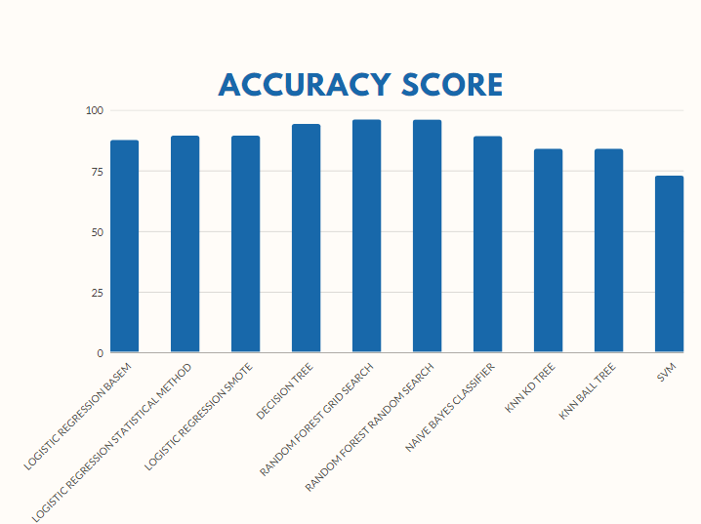
ACCURACY SCORE OF MODELS

Slide 19
CONCLUSION
Accuracy for Logistic regression Base model: 87.59460348798947
Accuracy for Logistic regression statistical method: 89.37150378413952
Accuracy for Logistic regression Smote: 89.37150378413952
Accuracy for Decision tree method: 94.20862125699243
Accuracy for Random forest_Gridsearch method: 96.15004935834156
Accuracy for Random forest_Randomsearch: 95.98552155314249
Accuracy for Naive_Bayes_classifier: 89.14116485686081
Accuracy for KNN kd tree: 83.94208621256992
Accuracy for KNN ball tree: 83.94208621256992
Accuracy for SVM: 72.91872326423166
Random Forest Algorithm and Decision Tree Algorithm gives the best model.

Slide 20
THANK YOU

